Slide 1
Senioritis x spelly
Flashcards Application

Slide 2
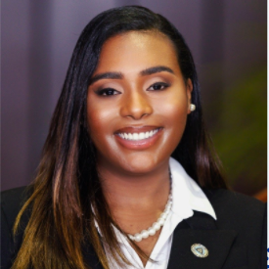


OUR TEAM
Zuri Levene-Harvell
Brittanie Rice
Jordan Still

Slide 3

ABOUT THE PROJECT
Flashcard application to help students of all ages
Aids in preparation for academic assessments
Environmentally-friendly

Slide 4
Use cases
Viewer searches by single subject
Viewer searches by Multiple subjects
Viewer selects a desired language
Viewer opens desired set
Viewer Studies an ordered set of flashcards
Viewer closes set
Overall Business Goals:
1. Increase user grades by 25%
2. Decrease Usage of Paper Flashcards by 90%
Viewer searches for a set of flashcards within a single subject based on what’s available through the online browser and databases
Viewer searches for a set of flashcards through multiple subjects based on what’s available through the online browser and databases
Viewer selects the desired languages, made available by the online browser and database, of sets to study.
Viewer has selected a set of flashcards that they would like to study.
Viewer will flip through the desired flashcard set in its original order. While flipping the Viewer will be prompted with quiz questions about the set, made by the database.
Viewer closes the opened flashcard set in order to find a new set

Slide 5
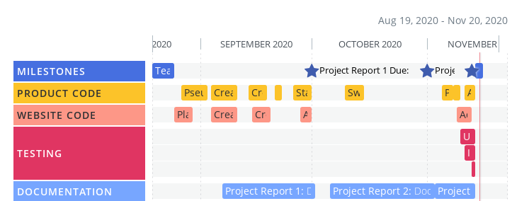
Roadmap

Slide 6

Application Demo
Please enjoy the demo of our application!

Slide 7
Future Functionalities
Author Creates a new flashcard set
Viewer studies a shuffled set
Viewer answers question Type
Browser reveals Viewer Score
Users under the Viewer role would be able to search for a set of flashcards through multiple subjects based on what’s available through the online Browser and Database
Users under the Author role would have the ability to create a new set and select the subject of the flashcards, which will be made available to Viewers through the Browser and Online Databases
Users under the Viewer role would be able to answer the question prompted, about the desired deck, in two different ways. One, type in their answer and then reveal if it was correct. Second, selecting the correct multiple choice answer. The results of each question will be recorded
The recorded score from the questions, that is stored in the online database, will be revealed to the Viewer, user, once they finish the deck on the Browser. The Viewer will also have the ability to view which questions are correct or incorrect.

Slide 8
Future Functionalities (cont.)
Viewer searches by Flashcard Set Name
Viewer selects more than type of Filter when Searching for set
Viewer can study with a partner
User, in the Viewer role, will have the ability to search for their desired set by name, created by Author. The database will populate the sets the apply then display them on the Browser to the Viewer
User, under the Viewer role, can apply multiple search filters simultaneously to find their desired set.
The Flashcard application would allow 2 or more users, in the Viewer role, to study the same set simultaneously in a partner mode. This would allow multiple users to study together and improve their knowledge on the subject or information

Slide 9
THANKS!
Any questions?
Visit our website @ https://brice2021.github.io/Flashcards/

